Slide 1
Lost Plateau
Game Development in Godot

Slide 2
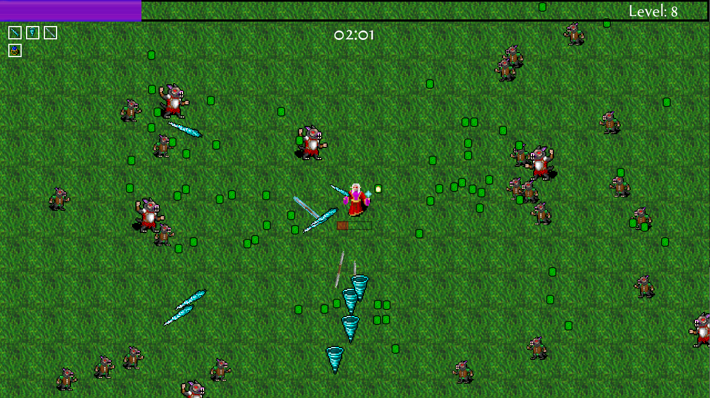
Project Overview
Adventure game
Rogue-lite elements.
Increasing difficulty
Procedural generation.

Slide 3
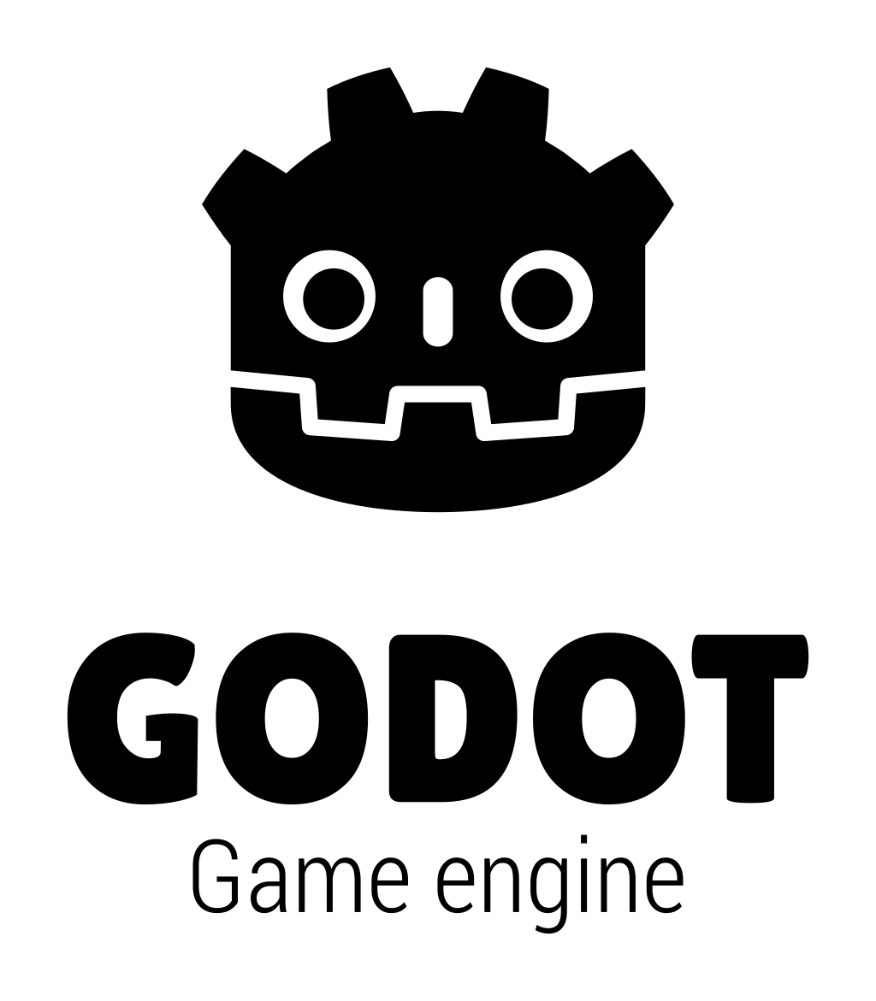
Why Godot?
Open-source and lightweight – No licensing fees, fully customizable
Uses GDScript (Python-like) – Simple syntax, easy to learn
Node-based scene system – Modular and flexible project structure
Built-in 2D tools – Optimized for 2D games like rogue-lites
Cross-platform support – Export to PC, mobile, and web

Slide 4
Technical Challenges
Inverted Y-axis: Godot's 2D coordinate system
the pixel increase as they go down the screen, and to the right. The origin starts at 0, 0 which is the top left of the screen.
originated with the scanlines of monitors and TVs back in the day
Node Communication:
Groups used to communicate upward in the scene tree.
Signals used to pass data down to child nodes.

Slide 5
Future Improvements
Additional Content: New levels, enemy types, and unique weapons to expand gameplay variety.
Enhanced AI: Smarter and more dynamic enemy behaviors for greater challenge and replayability.
Mobile Compatibility: Optimize performance and controls for mobile devices to reach a wider audience.

Slide 6
Game Mechanics - Survival
Stronger and more plentiful enemy spawn as time progresses
Coming into contact with an enemy lowers your health
You can't move through enemies
Survive to 5 minutes to win

Slide 7
Game Mechanics - Attacking
Periodically shoot projectiles based on any weapons you have
Ice spear: shoots a random enemy on screen
Tornado: shoots a tornado forward in your current direction
Javelin: flies at a random enemy piercing anything on its way

Slide 8
Game Mechanics - Upgrading
Enemies drop gems on death
Picking up gems gives experience
After enough experience, you can pick a random upgrade
The most powerful upgrades require prerequisite upgrades first

